Slide 1
CM 1607 ENGLISH COMMUNICATION SKILLS
Lecture 1 covering LO1 and LO 2
Introduction (LO’s etc. general)
Grammar: Articles
Types of writing - Academic Writing

Slide 2
Learning Outcomes of the module
On completion of this module, you will be able to:
Use suitable grammar and vocabulary in an academic setting as well as in the working world
Demonstrate the ability to write grammatically correct, essays, and other forms of writing of academic standard.
Prepare suitable slides and make a clear, concise presentation, displaying professional presentation techniques and display suitable listening skills where you gather the gist of a talk, lecture or presentation.
Use various reading techniques like skimming, scanning, summarising to demonstrate the ability to read.

Slide 3
Your assessments will be:
Examination 60%
Closed book 2 hours’ duration. Written examination.
Coursework 20%
A take home assignment. Watch the video on which your group did the presentation and analyze it, then write an essay, 250 words.
Group presentation 20%
You will be divided into groups of 5. Three different videos will be given to select from. 15 minutes per group, followed by a 5 minute viva

Slide 4
Indicative module content:
Remedial English / Grammar – not in isolation - and study of suitable academic vocabulary
Oral Communication: in-class discussions, speeches, presentations, general conversation
Written Communication: essays, emails, articles, abstracts etc.
Specialised writing: report writing, descriptive writing, technical and scientific writing.

Slide 5
Indicative module content (Cont’d)
Group discussions: turn-taking, conducting meetings.
Presentation techniques – formal and informal presentations (group or individual).
Reading techniques: skimming, scanning and extensive reading, reading for understanding (comprehension).
Listening: for important information, for specific information.

Slide 6
Let’s review some grammar…
Look at the following sentences:
1) My father bought new car.
2) I have good laptop
3) She gave him birthday present.
What is missing? Yes, the word a.
1) My father bought a new car.
2) I have a good laptop.
3) She gave him a birthday present

Slide 7
Articles (a, an, the)
“A/an” and “The” are the two types of English articles.
There are rules to help you decide which one to use, but first, you need to know what type of noun you are using.
Let’s take a look at handout 1.
There will be a few more practice activities in the tutorial.
Useful links:
https://owl.purdue.edu/owl/general_writing/grammar/using_articles.html
https://learnenglish.britishcouncil.org/grammar/beginner-to-pre-intermediate/articles-1
https://www.youtube.com/watch?v=sZDPFYFH41Q Don’t forget to watch this video later

Slide 8

TYPES OF WRITING
Warm up: Get into pairs and list or recall the various types of writing you have used or you have heard of.
Today’s focus: ACADEMIC WRITING
Handout 1 – Activity 1 to be done.
Activity 2 will be done at the tutorial.

Slide 9
The Writing Process
Let’s watch this video
https://www.youtube.com/watch?v=edZkuHHXDlo

Slide 10
Academic Writing (Cont’d)
WHAT IS ACADEMIC WRITING?
Broad definition:
any writing done to fulfill a requirement of a college or university.
publications read by academics and researchers or presented at conferences.
any writing given in an academic setting.

Slide 11
Academic Writing (Cont’d)
What documents will have academic writing?
Conference papers
Research papers or articles
Books and book reports
Translations
Academic journals
Abstracts / Executive Summary
Explications (an explanation, interpretation)
he gave a brilliant explication of James Joyce's book.
Essays Dissertations & Thesis

Slide 12
Academic Writing (Cont’d)
What are the characteristics of academic writing?
Planning: analytical and organized.
Outline: A must. Will help formulate thoughts, make you aware of certain relationships between topics. Will help you to determine the appropriate information to be included in your paper.
Tone: Formal. DO NOT USE slang words, jargon,
short forms, (abbreviations) or clichés.

Slide 13
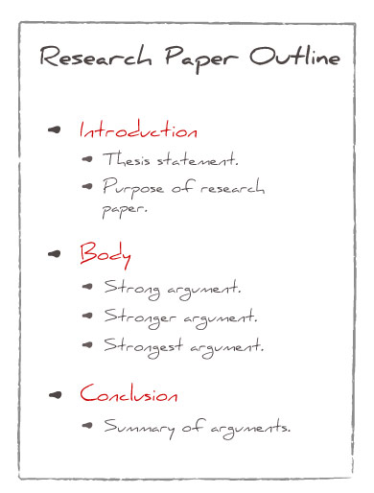
Academic Writing (Cont’d)
Example of an outline:

Slide 14
Academic Writing (Cont’d)
Language: clear (clarity) and (accurate) accuracy.
Point–of–view: 3rd person. focus is to educate on facts.
e.g. We gathered our data from the general public. – The data was gathered from the general public.
Approach: Deductive reasoning as readers need to follow how you arrived at your conclusion and an Analytical approach.
IMPORTANT: Check with your institution the preferred format and style. (IIT) - Harvard

Slide 15
Let’s avoid these errors … video
Let’s watch this video which tells you what errors to avoid
in academic English
https://www.youtube.com/watch?v=mZQgd2sPxpk&t=221s

